Slide 1
Database DevOps
Section 1

Slide 2
1.1 - Overview

Slide 3
Title slide?

Slide 4




Steve Jones
SQLServerCentral Founder
Redgate Software Evangelist
www.voiceofthedba.com
sjones@sqlservercentral.com
@way0utwest
/in/way0utwest

Slide 5
Course Structure
This course consists of
Lectures and videos of course material
Assessment questions after each section
Hands on labs for you to practice skills

Slide 6
Course Overview
In this course, you will learn how to:
Define DevOps
Identify the challenges of database DevOps
Include your database code alongside other application code in source control
Setup a Continuous Integration (CI) platform for your database code.
Write and include automated unit tests for your database code.
Develop an automated release process that deploys database changes

Slide 7
1.2 – What is DevOps?

Slide 8
What is DevOps?
“DevOps is the union of people, process, and products to enable continuous delivery of value to our end users.”
Donovan Brown
Microsoft Principal DevOps PM
From http://donovanbrown.com/post/what-is-devops

Slide 9
What is DevOps?
“It is very important to realize that DevOps is not a product. You cannot buy DevOps and install it. DevOps is not just automation or infrastructure as code. DevOps is people following a process enabled by products to deliver value to our end users.”
- Donovan Brown

Slide 10
The Three Ways
Gene Kim of The Phoenix Project and The DevOps Handbook, lists three core principles of DevOps
Systems Thinking
Feedback Loops
Culture of Continuous Learning and Experimentation

Slide 11
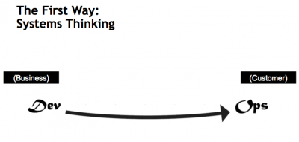

Slide 12
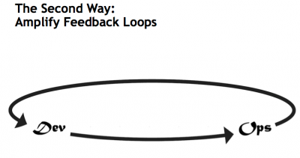

Slide 13
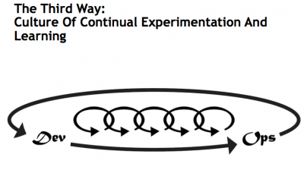

Slide 15
1.3 – Challenges

Slide 16
Why are databases different?
“It Depends”
Some code is (almost) the same (views, stored procedures, functions)
Some code isn’t (tables, indexes, security)
These structures maintain state
They can be cumbersome to change
Versioning might not work

Slide 17
1.4 – Non-Technical Challenges

Slide 18
Non-Technical Challenges
Different staff responsibilities
Change and improve v stability and performance
Liability for issues
Staff Knowledge
Fundamental nature of code management and deployment
Habits for working with systems
Data Challenges
Data migration between environments
Data changes between environments
Drift

Slide 19
1.5 – ORMs?

Slide 20
1.6 – State v Migrations

Slide 21
State Based Database Development
Capture the “state” of all code at a point in time (a snapshot)
Compare this state with another version of this state
Can be database to database
Can be VCS to database
Use the comparison to generate a script that will deploy changes from one version to the next.

Slide 22
State Based Database Development
Advantages
Simple for developers, nothing to track
Transient changes (those not needed) are not transferred
Branching and merging is (relatively) easy
Simplicity
Disadvantages
Some changes cannot be captured with snapshot comparisons
Upgrades of databases tend to require known starting/ending points.
Multiple versions of databases are not easily upgraded

Slide 23
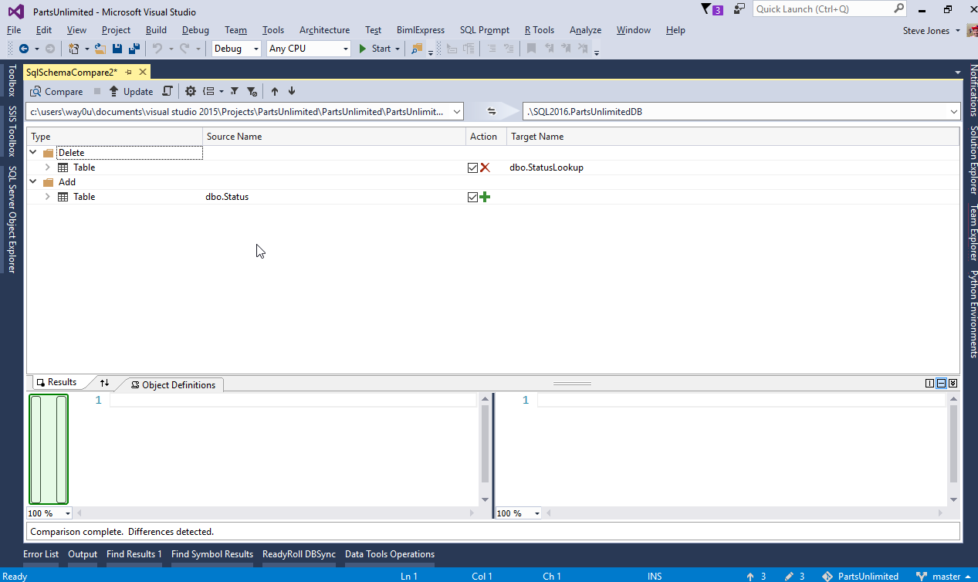

Slide 24
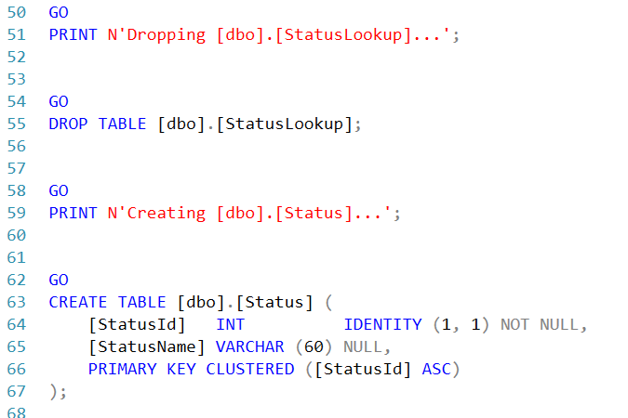
Generated script for table rename

Slide 25
Migration Based Database Development
All changes made to a database are tracked as they are made.
Changes are ordered and executed in the same order on downstream environments
The actual code a developer executes is replayed in downstream environments.

Slide 26
Migration Based Database Development
Advantages
The exact code is executed in all environments, ensuring repeatability and reliability.
Any version of a database can be upgraded to any other version
Disadvantages
Changes need to be tracked
Ordering is important and merging branches of development can be complex
Lots of scripts may need to be run, lengthening deployment

Slide 27
1.7 – State v Migrations

Slide 28
Building Better Collaboration

Slide 29
1.8 – Lab Setup

Slide 30
Hands On Lab
The lab for this course will walk you through the setup of a series of databases where you will implement a CI process, and deploy changes to downstream environments.
We will use these environments:
A local development SQL Server database
A local integration SQL Server database
A git repository, linked to a VSTS repository
A local QA database
A remote Azure SQL Database

Slide 31
Hands On Lab
Requirements
A Windows host capable of supporting Visual Studio 2017 and SQL Server
Visual Studio 2017 Enterprise – an evaluation edition can be used
SQL Server Developer Edition (localdb can be used)
The tSQLt testing framework
The tSQLt testing adapter
An Azure subscription – If you do not wish to use Azure, you can create a production database on your local machine

